Slide 1
SteganoGo
Mihai Țimbota-Belin

Slide 2
Continut
Steganografie
Steganografia in IT
De ce Go?
Tehnica LSB

Slide 3

Steganografie
Steganos (ascuns, acoperit) + graph (a scrie)

Slide 4
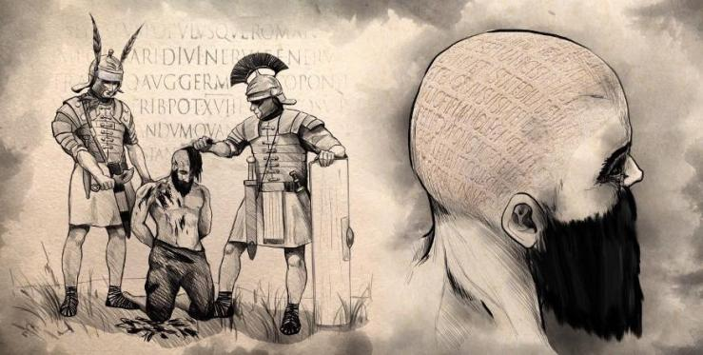
Origini

Slide 5


Steganografia in IT
Cover-File
Embedded-File
Stego-File

Slide 6
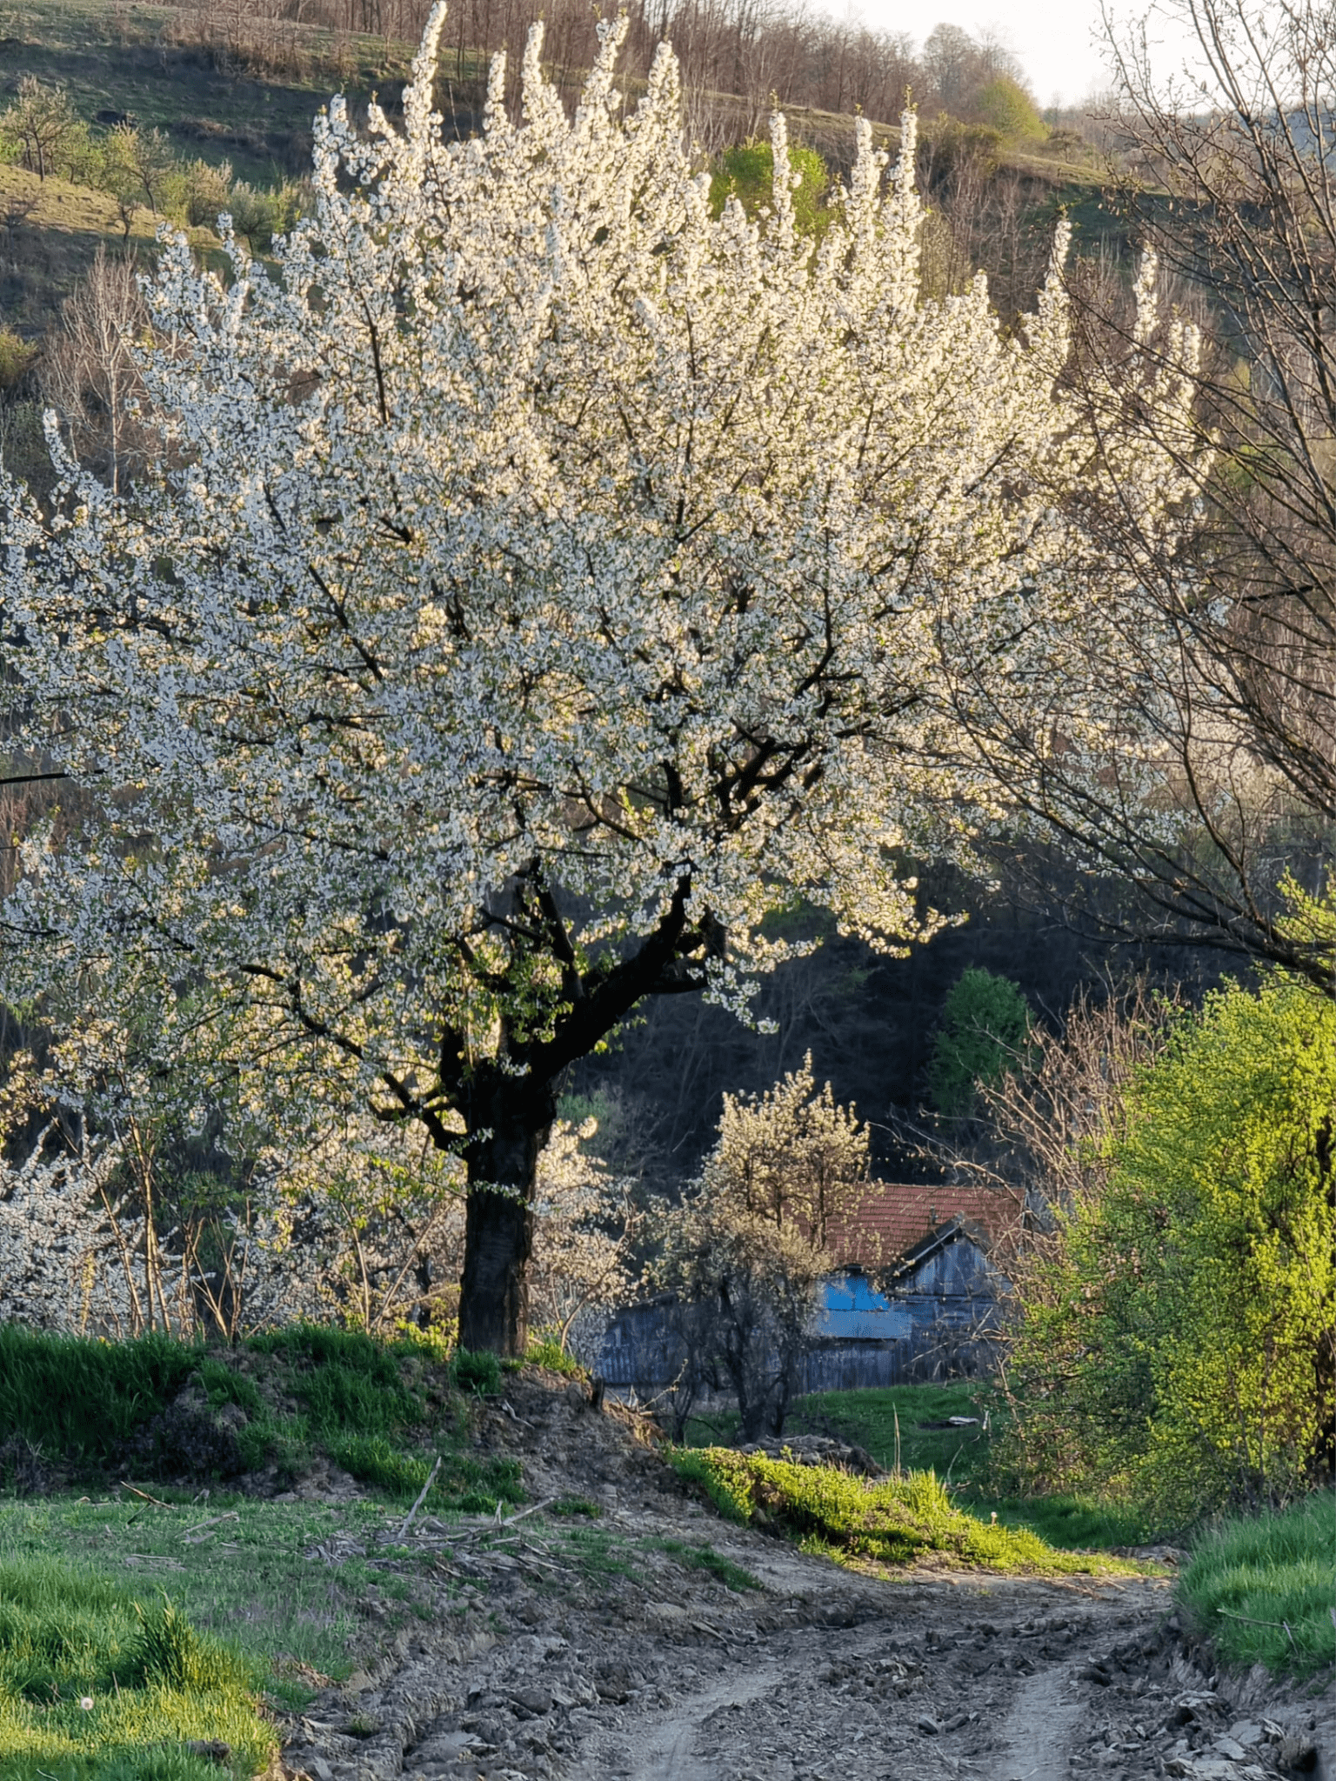


Exemple
Imaginea 1
Imaginea 2
Imaginea 3

Slide 7
Imaginea 1
Imaginea originala

Slide 8
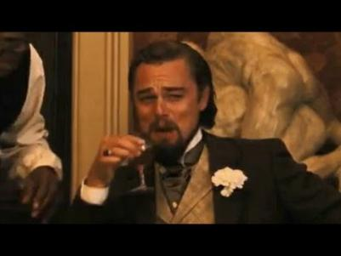
Imaginea 2

Slide 9
Imaginea 3
War and Peace, Lev Tolstoi
( ~ 528.000 cuvinte)
Format epub

Slide 10

De ce Go?
Eficient
Usor de invatat
Scalabil
Modul de tratare al erorilor

Slide 11


Tehnica Least Significant Bit
Payload
0
1
1
R = 1001 1110
G = 0001 1010
B = 0001 1010
R = 1001 1110
G = 0001 1011
B = 0001 1011
P₀₀ :
P₀₀ :
Cover-file
Stego-file
P₀₀
P₀₁
R = 0001 1011
G = 0010 0000
B = 0110 0110
0
0
1
R = 0001 1010
G = 0010 0000
B = 0110 0111
P₀₀
P₀₁
P₀₁ :
P₀₁ :
P₁₀
P₁₁
R = 0101 0001
G = 1100 1010
B = 0011 1111
1
0
0
R = 0101 0001
G = 1100 1010
B = 0011 1110
P₁₀
P₁₁
P₁₀ :
P₁₀ :
1
1
0
R = 0111 1011
G = 0000 1111
B = 0110 0011
R = 0111 1011
G = 0000 1111
B = 0110 0010
P₁₁ :
P₁₁ :

Slide 12
Bibliografie
www.libpng.org/pub/png/spec/1.2/PNG-Contents.html
https://medium.com/@.Qubit/what-is-steganography-92c9a611456b
https://www.invata-online.ro/infosec/data-security/steganografie
https://pyokagan.name/blog/2019-10-14-png/
Presentation template by SlidesCarnival

Slide 13
Thanks!
Any questions?

